Slide 1
What exactly are you planning to talk about???
Recent Advances in Our Understanding of the Prebiotic Molecular Complexity in Astronomical Environments.
Anthony Remijan
NA ALMA Regional Center

Slide 2
So… Let’s go over the abstract…
“…observations of a variety of astronomical environments has led to the detection and characterization of new molecular species as well as to a better understanding of the physical and chemical conditions of these regions…”
Since 2004, there have been 76 new molecule detections!
We have seen the “eye chart” in many different colors but another way to look at it is the following:
IRAM: Astrochemistry featured as ‘key science’ in every annual report since 2004 and has >2 Large Programs dedicated to large spectral line surveys.

Slide 3
So… Let’s go over the abstract…
“…Molecular material is now found in a host of Galactic and extragalactic environments and has been used as tracers of a variety of conditions including but certainly not limited to:
PDRs, XDRs – Guzman (Tues)
Shocks – Codella (Tues)
diffuse gas – van Dishoeck (Mon)
dense gas – McGuire (Mon), Jimenez-Sierra (Tues)
HMCs/UC HII regions – Belloche (Mon), Beltran (Mon), Fontani (Mon), Drozdovskaya (Tues), Rivilla (Wed)…”
Disks – Guzman (Tues)
Comets – Milam (Wed)
Moons/Asteroids – Charnley (Wed), Chuang (Wed)
…everyone I forgot to mention and all the posters.

Slide 4
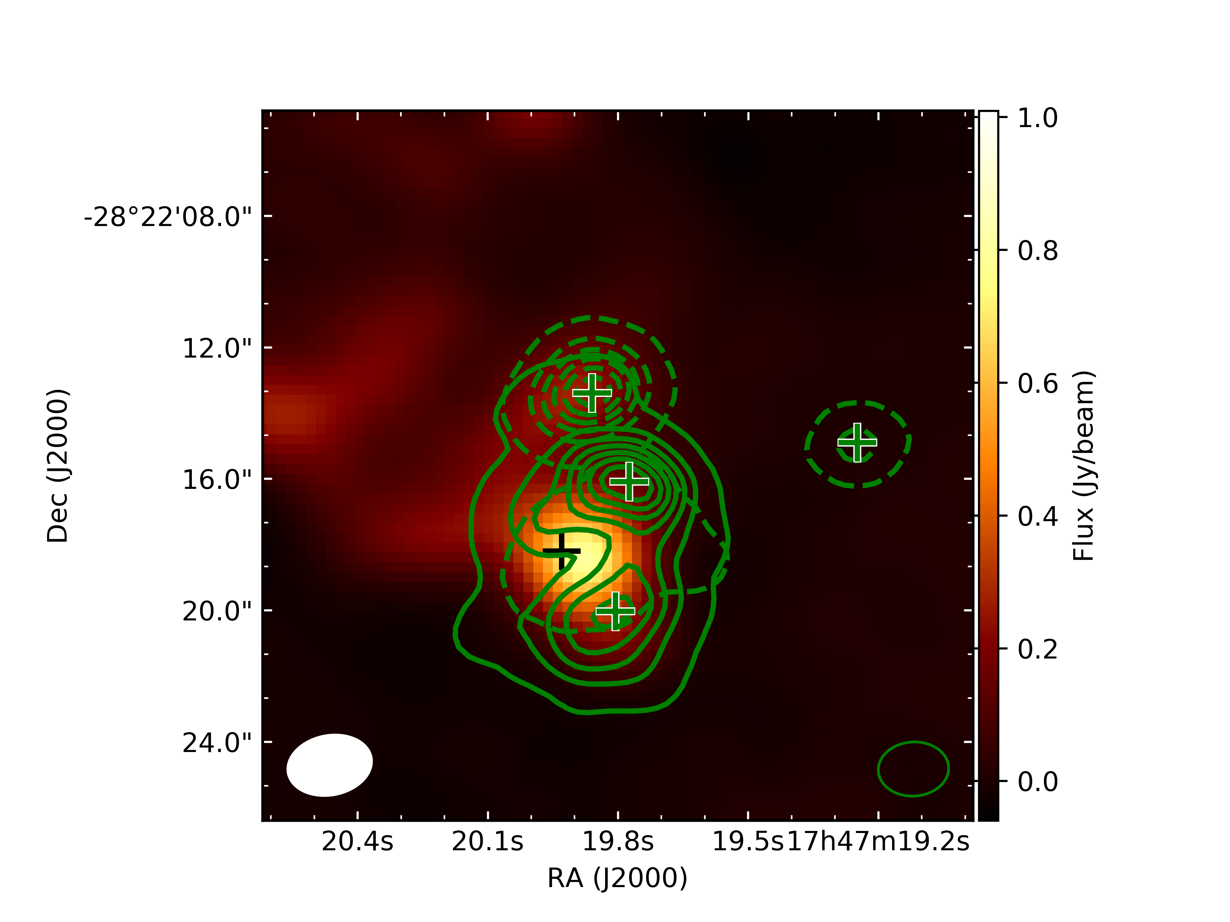
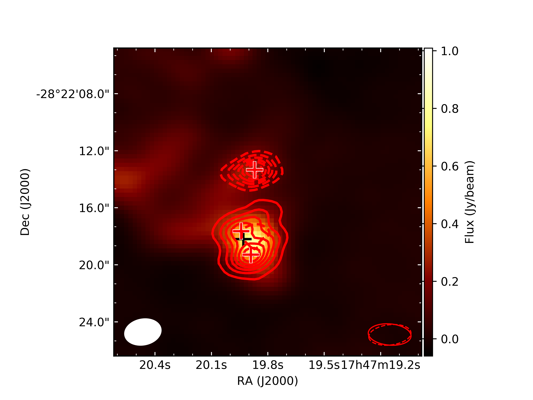
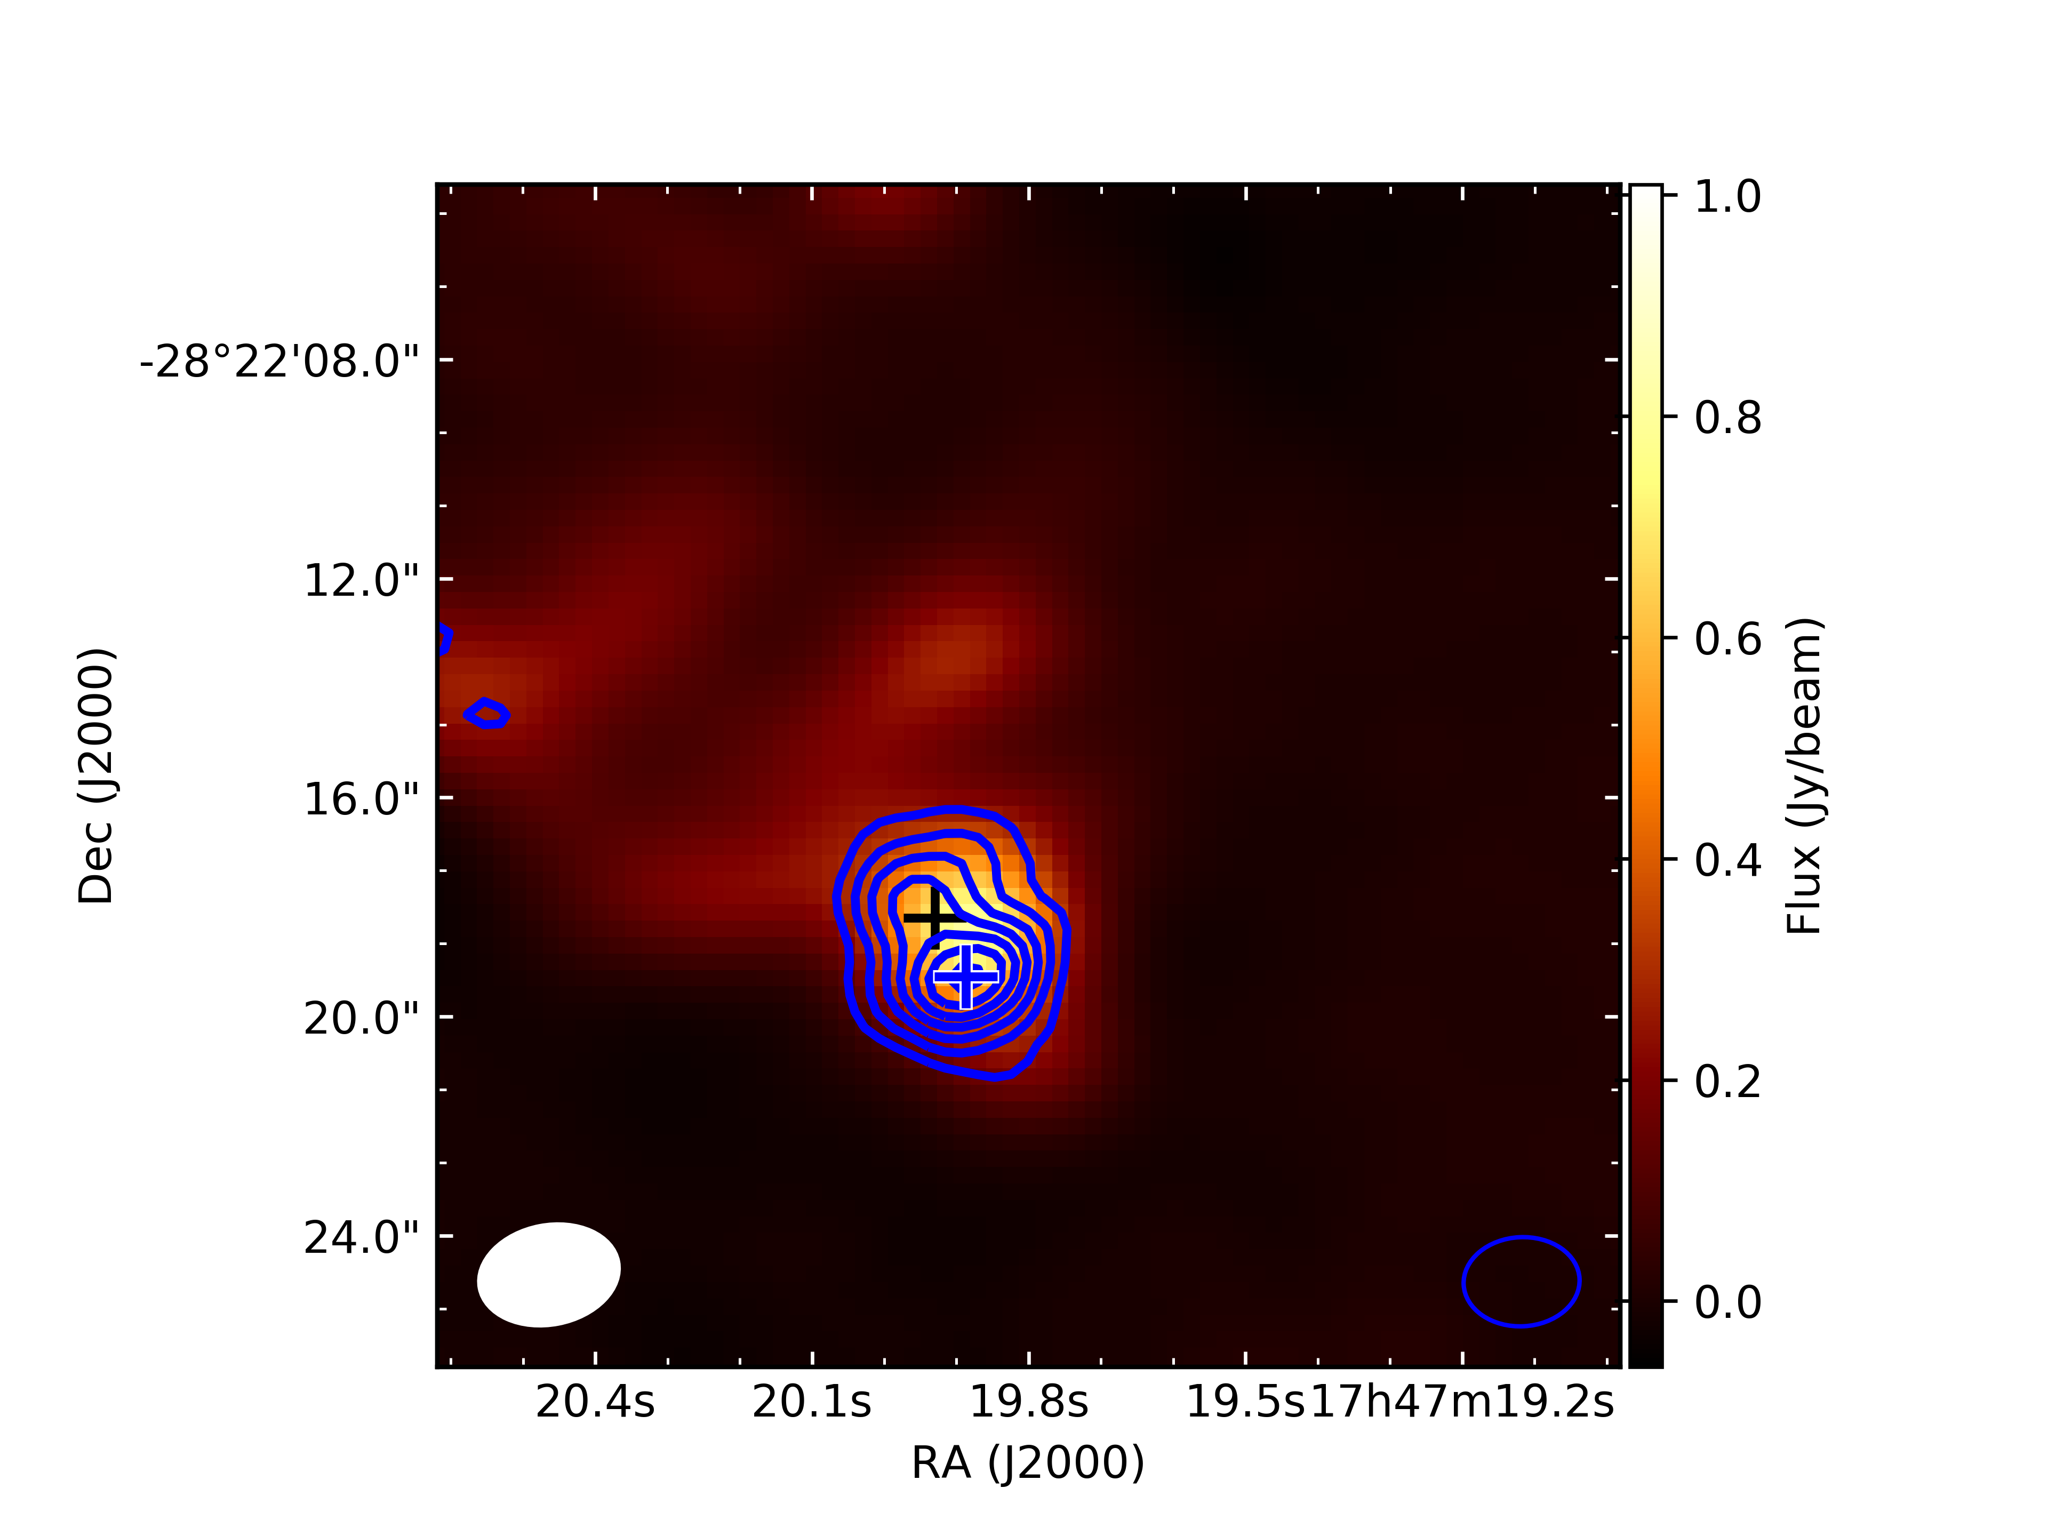
So… Let’s go over the abstract…
“…In the era of large single dish telescopes and broadband interferometric arrays, we are truly getting a chemical picture of the universe…”
Methyl Formate
Glycolaldehyde
Acetic Acid

Slide 5
What’s left to talk about…?
(after all, there is a LOT of discovery space left!)
If we are going to continue to detect new Large Astronomical Molecules, we are going to need to start considering:
New Frequencies
New Sources
New Technologies

Slide 6
Question was asked earlier in the week, “how big of a molecule can we detect”?
If we consider an “average” large molecule (~10 atoms) with a moderate dipole moment (~ 1 Debye) toward a hot core (~ 100K)
At mm wavelengths, we can detect species with a column density of about ~10¹⁵⁻¹⁶ cm⁻² in a “reasonable” amount of time with existing facilities.
At cm wavelengths, in cooler regions (~20K) we can do better, down to about ~10¹³ cm⁻² in a “reasonable” amount of time
(lower column densities are possible with molecules with large dipole moments - 10¹⁰⁻¹¹ cm⁻² in a “reasonable” amount of time.)
So, how do we get down to lower column densities?

Slide 7
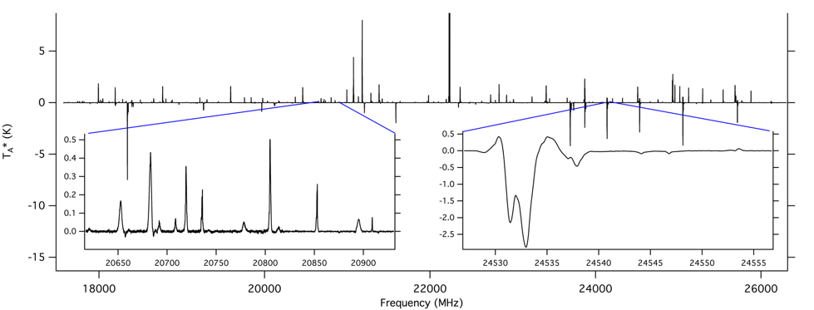
New Frequencies…
The GBT PRIMOS Program - PRebiotic Interstellar MOlecular Survey
Scientific Motivation
Target: Sgr B2(N-LMH)
Coverage: 40.4 GHz of Bandwidth from 300 MHz - 50 GHz
Noise level of ~2 mK
Publicly available with no proprietary period
Plan to extend the survey up to 92 GHz (W-band)
Jan M. Hollis, Anthony J. Remijan, Philip R. Jewell, Frank J. Lovas, Joanna F. Corby, Brett A. McGuire - www.cv.nrao.edu/~aremijan/PRIMOS/
http://www.cv.nrao.edu/~aremijan/SLiSE/

Slide 8
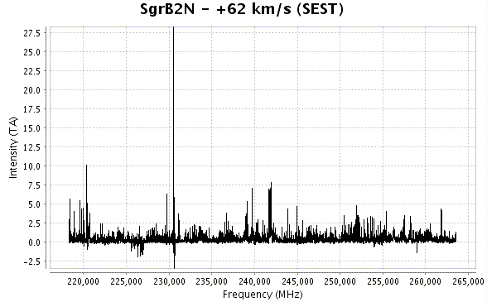
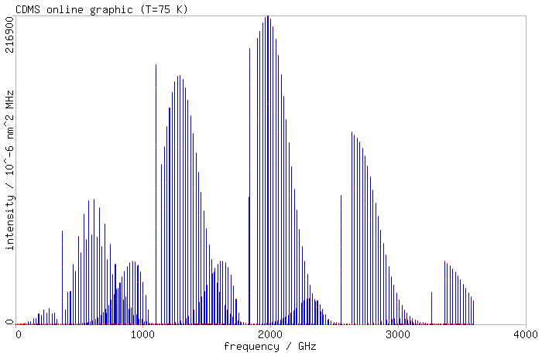
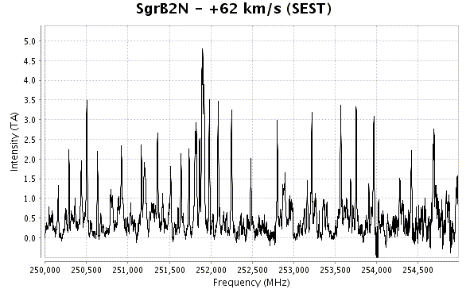
New Frequencies…
The GBT PRIMOS Program
Scientific Motivation
Why waste our time in the cm?
Most of the “favorable” transitions should be in mm! Certainly many more transitions to select from… BUT, major line confusion problem and what if the transitions are not in LTE?
Submillimeter Spectrum of HNCNH

Slide 9
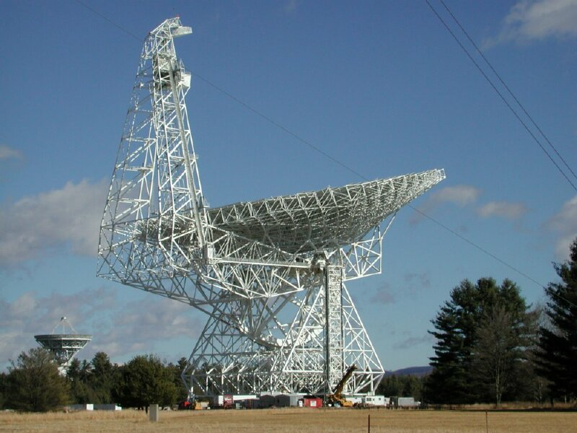
GBT Spectroscopy and Astrochemistry
The GBT PRIMOS Program
Observing Methods
OFF(2 min)-ON(2 min)‏ Position Switching Mode
Necessary in order to mitigate interference from other spectral features
When the Survey was approved, toward Sgr, use 4x200 MHz windows for a spectral resolution of ~24.4 kHz. Total time requested was well over 800 hours.
VEGAS – use 4x850MHz spectrometers at 61kHz.
The GBT has been instrumental in searching for large, organic and prebiotic species.
21+ publications and 6 new species have been detected since the survey started.
acetamide
methyltriacetylene
cyclopropenone

Slide 10
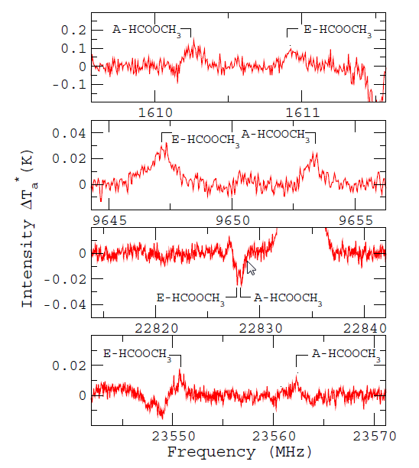
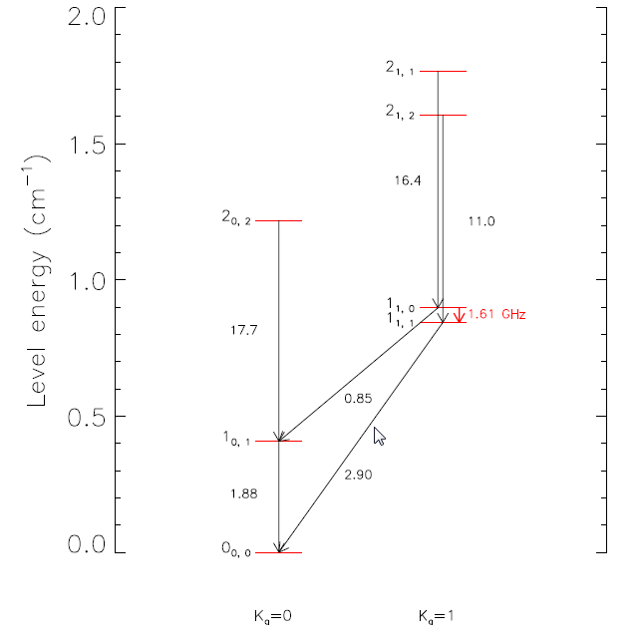
New Frequencies
The GBT PRIMOS Program
The characterization of complex organic molecule emission at low frequencies – new astronomical masers.
These results are in sharp contrast with interferometric observations showing that HCOOCH₃ resides predominantly in the compact (6.5") LMH hot core near Sgr B2(N) (Miao et al. 1995).
This source is indeed characterized by very high densities (> 10⁷ cm⁻³) and gas temperatures (>100 K). Assuming a source size of 4“ and a rotational temperature of 80 K, a column density of 4.5x10¹⁷ cm⁻² (Belloche et al. 2009, 2013)
Weak Maser Emission of Methyl Formate toward Sagittarius B2(N) in the Green Bank Telescope PRIMOS Survey
Faure, A.; Remijan, A. J.; Szalewicz, K.; Wiesenfeld, L. – 2014, ApJ, 783, 72

Slide 11
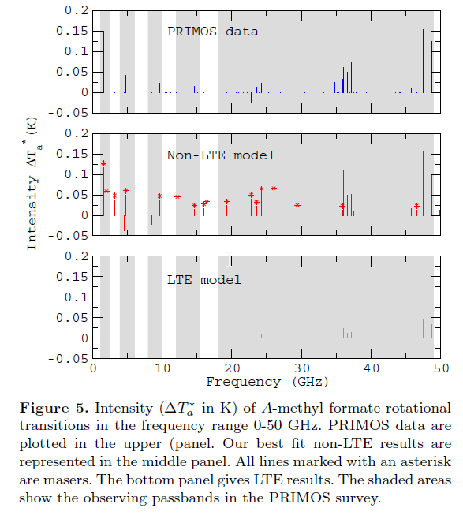
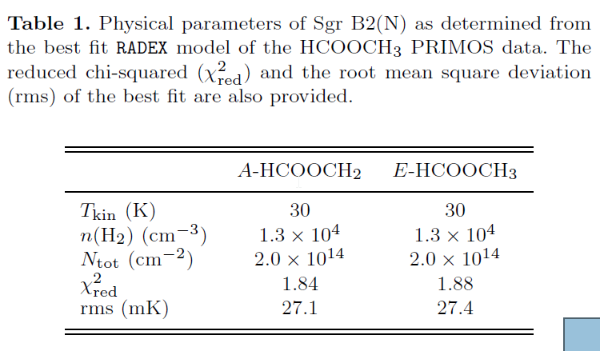
New Frequencies
The GBT PRIMOS Program
The characterization of complex organic molecule emission at low frequencies – new astronomical masers.
The conclusion is that all detected methyl formate lines below 30 GHz are masers!
Q. What mechanisms are pumping these new masers?
A. Can mapping the distribution give insight to excitation and possible formation?

Slide 12
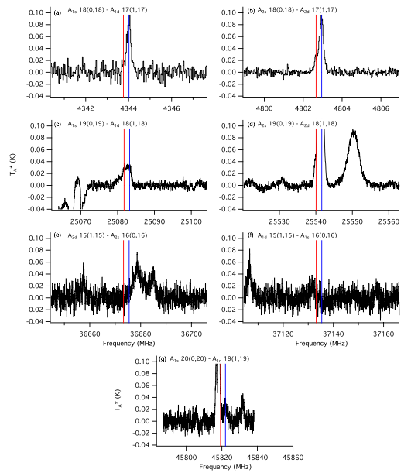
New Frequencies
The GBT PRIMOS Program
Detection of Interstellar Carbodiimide via maser action.
Lines at 4 GHz
+64 and +82 km s⁻¹
+64 and +82 km s⁻¹
CH3OH Line
H Recomb Line
CH3OH Line
No lines!
(you are okay if you can explain why!)
CH3OH Line
+64 km s⁻¹
Interstellar Carbodiimide (HNCNH): A New Astronomical Detection from the GBT PRIMOS Survey via Maser Emission Features
McGuire, Brett A.; Loomis, Ryan A.; Charness, Cameron M.; Corby, Joanna F.; Blake, Geoffrey A.; Hollis, Jan M.; Lovas, Frank J.; Jewell, Philip R.; Remijan, Anthony J. – 2012, ApJ, 758, 33L

Slide 13
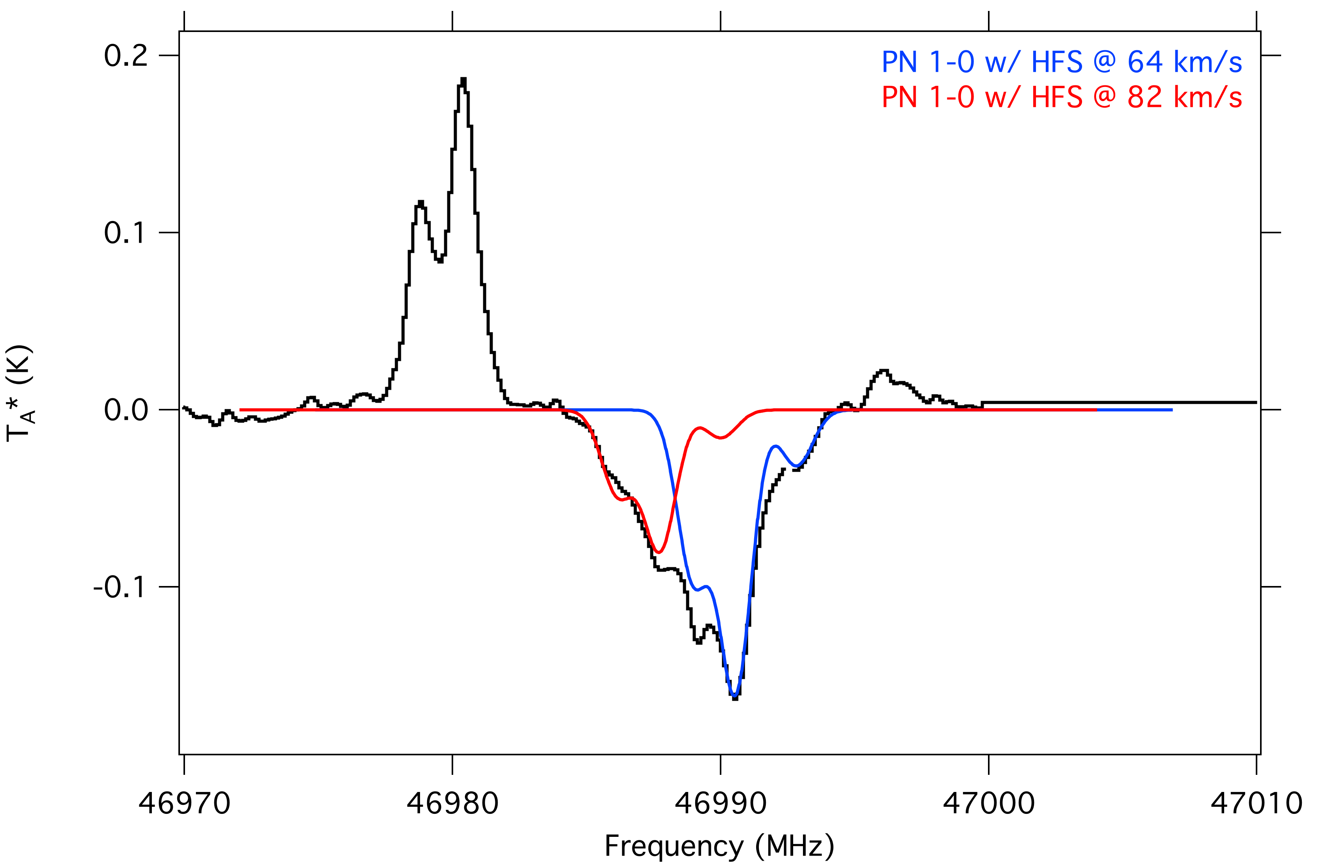
New Frequencies
The GBT PRIMOS Program
Detection of hyperfine structure of PN towards the Galactic Center… yes, in absorption!

Slide 14
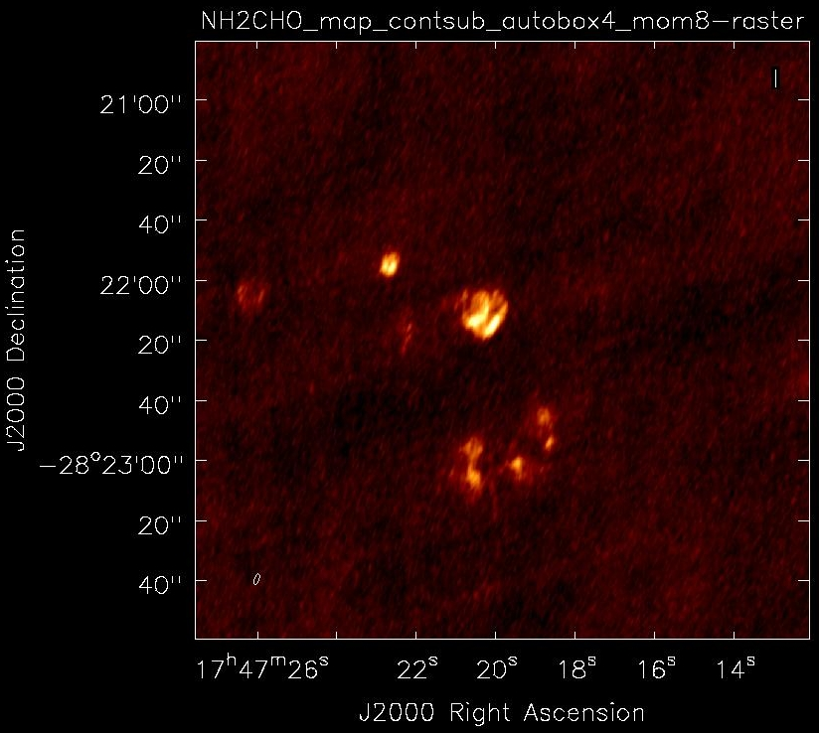
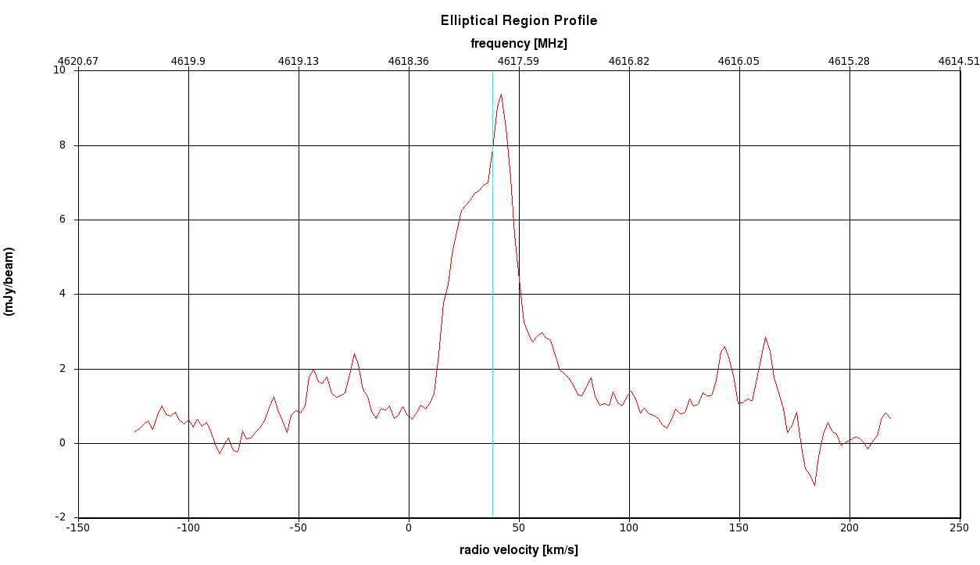
New Frequencies
High Resolution observations of
Formamide (NH₂CHO)

Slide 15
New Sources
“The galaxy evolution community needs 100,000 galaxies before they know anything…” EvD
PRIMOS 2018+
Investigate these molecules in a myriad of sources. No need to continue to look at the “best and the brightest” sources in the sky. This will help us to better understand the chemistry from the ISM to planetary systems…
PRIMOS-2 will expand the survey beyond Sgr toward Orion KL and the Orion Bar

Slide 16
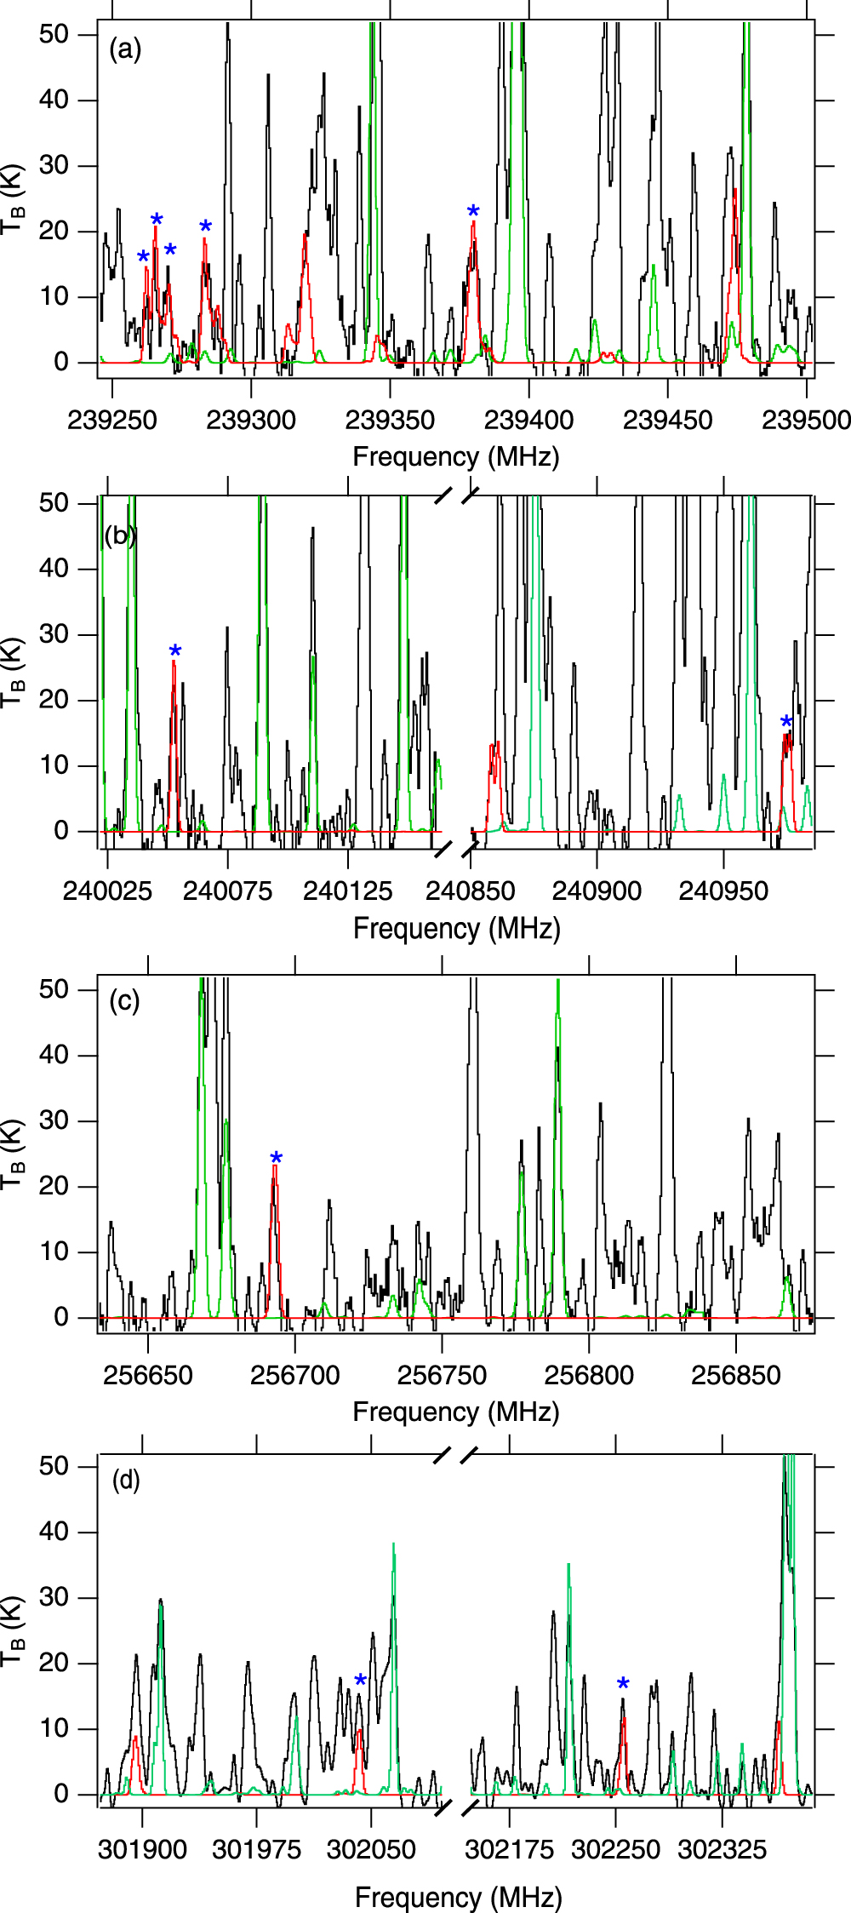
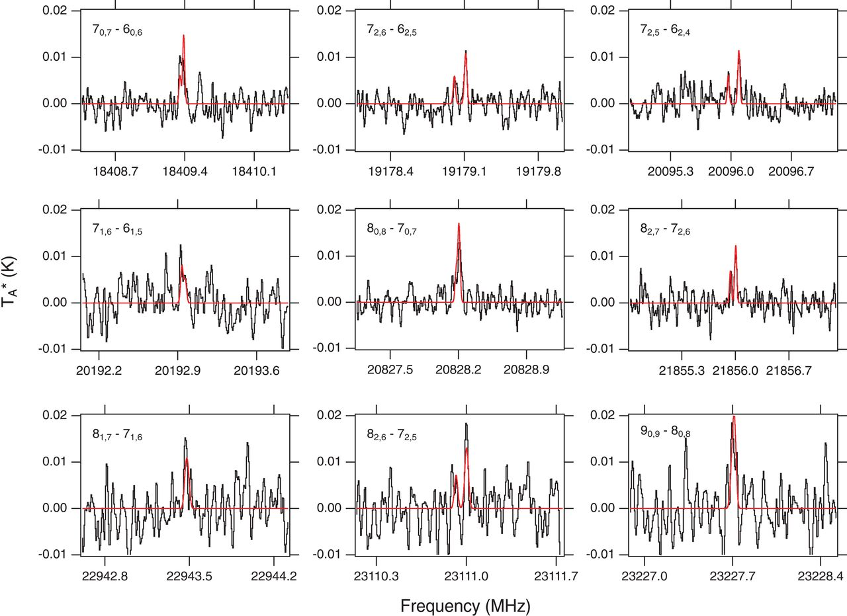
New Sources
Detection of benzonitrile toward TMC-1
Full bandscan at all GBT frequencies ~ 1300 hours
Detection of methoxymethanol toward NGC6344I
Full bandscan at all GBT frequencies ~ 400 hours

Slide 17
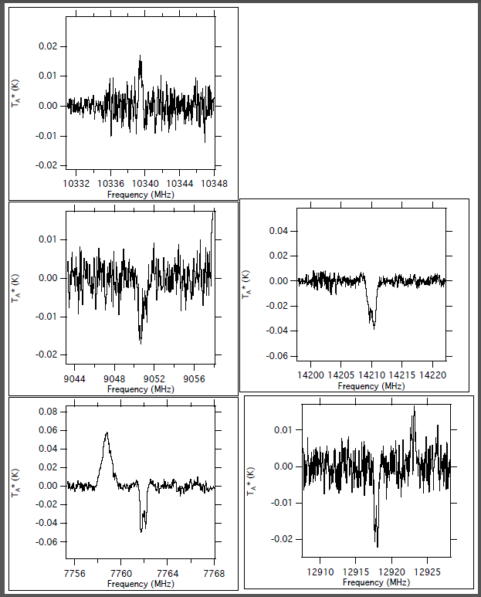
New Sources
PRIMOS 2018+
What is the next molecule to look for? (This is what we want from the models!)
“Reaction Screening” experiments have yielded several new molecular species including cyanomethanimine and ethanimine. Possible new species include aminoacetaldehyde and acetylcyanide…or…
Characterizing the full spectrum IS CRITICAL in the investigation of new species.
We have found a seemingly related series of features from C-Band thru Ku-Band so if we are to identify this species, as broad frequency coverage as possible is necessary…

Slide 18
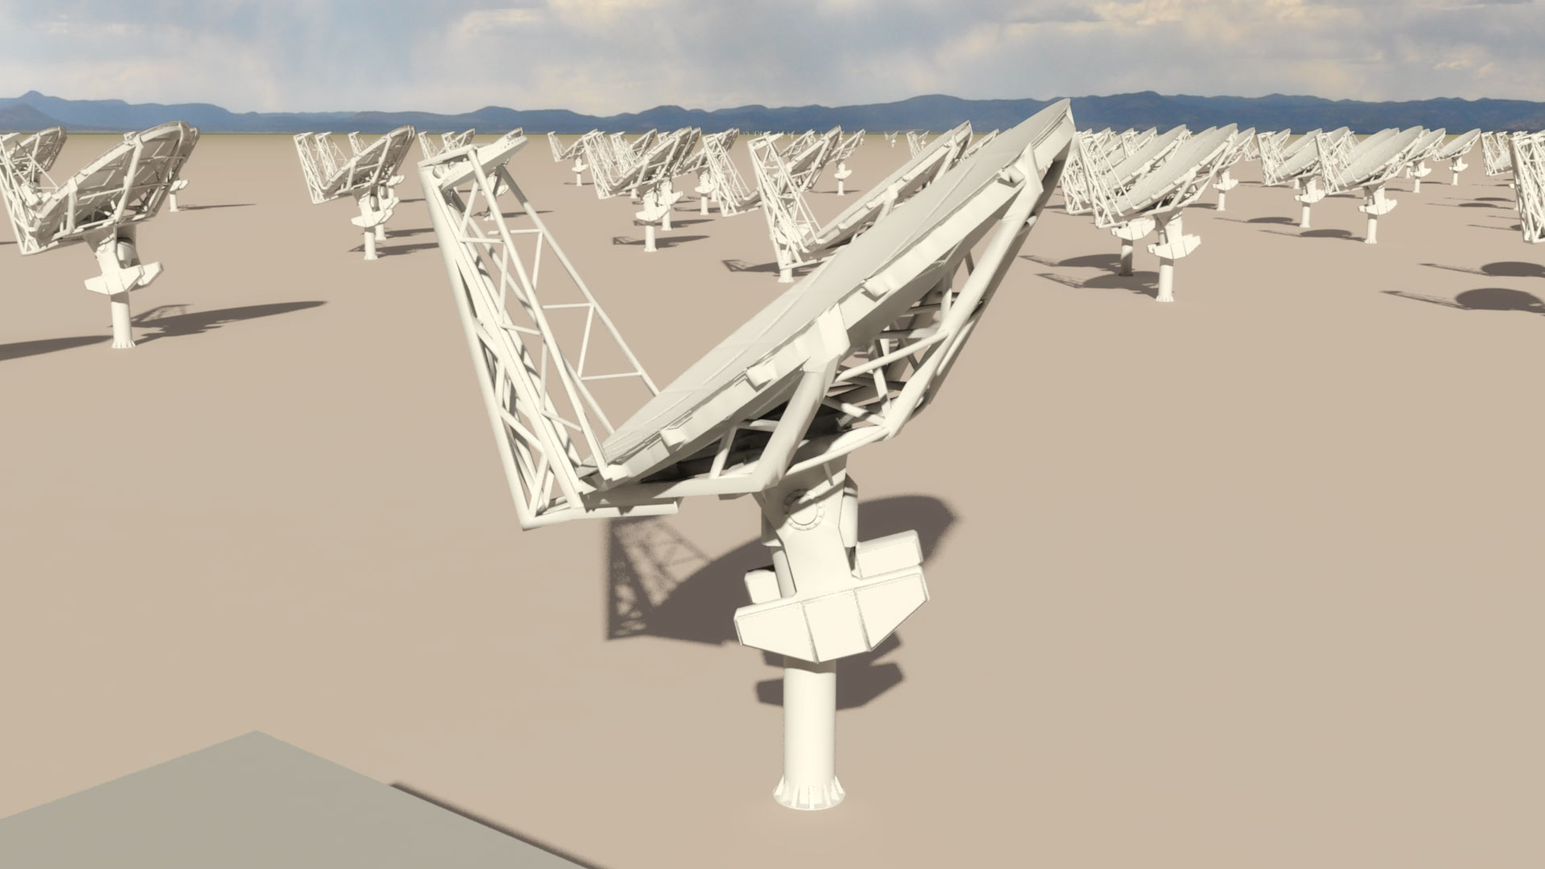
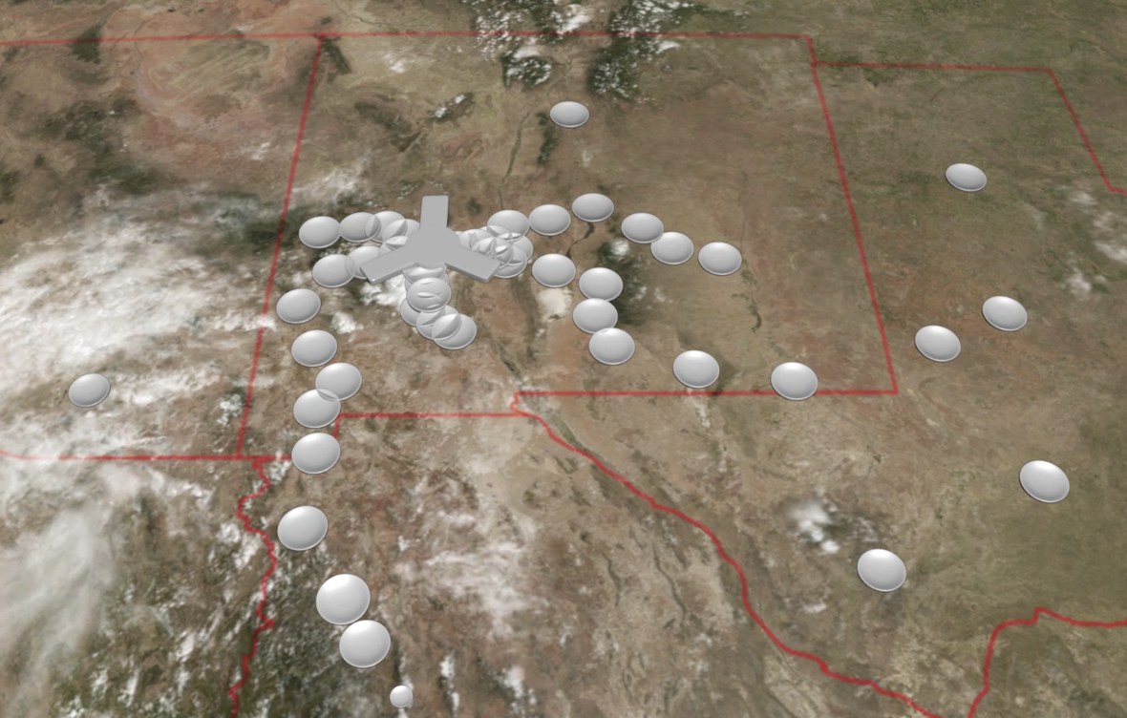
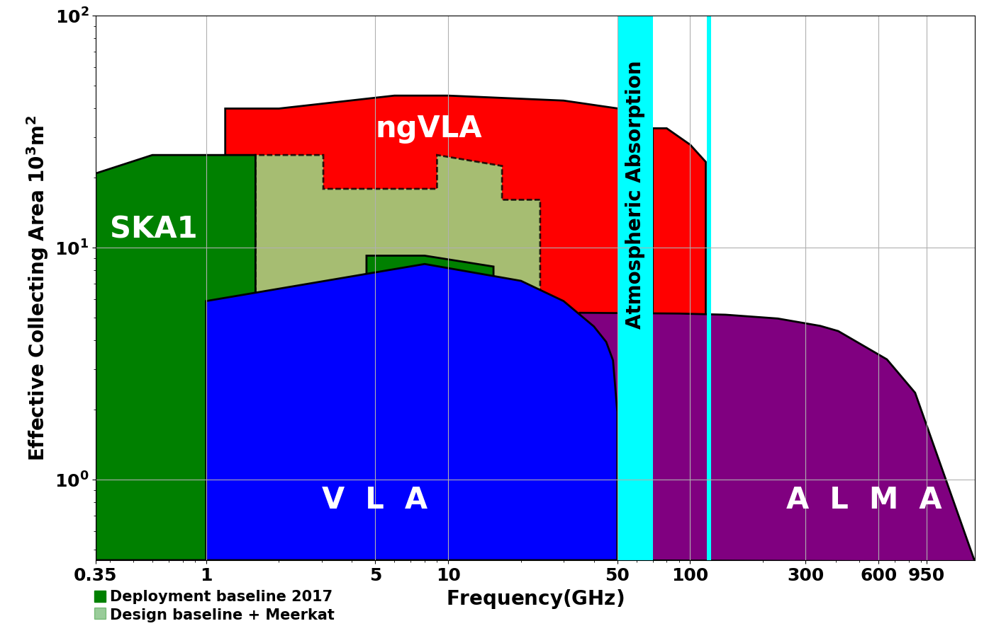
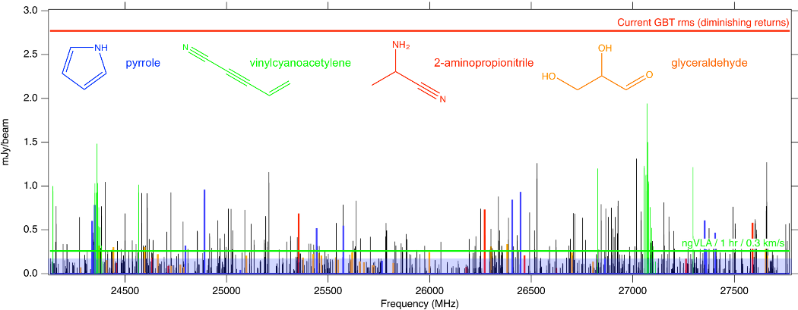
New Technologies – next-generation VLA (ngVLA)
Scientific Frontier: Thermal imaging at milli-arcsec resolution
Sensitivity/Resolution Goal:
10x sensitivity & resolution of JVLA/ALMA
Frequency range: 1.2 –116 GHz
Located in Southwest U.S. (NM+TX) & MX, centered on VLA
Baseline design under active development
Low technical risk (reasonable step beyond state of the art)
50% in core: b < 3km ~ 1”
80% in mid: b < 30km ~ 0.1”
100% in long: b < 500km ~ 0.01”
550 km
Complementary suite from meter to submm arrays for the mid-21st century
< 0.3cm: ALMA 2030
0.3 to 3cm: ngVLA
> 3cm: SKA
http://ngvla.nrao.edu
Probing the Initial Conditions for Planetary Systems and Life with Astrochemistry
Highly synergistic with next-generation ground-based OIR and NASA missions.

Slide 19
What can we do now?
What I am proposing is a full community driven initiative (similar to the VLASS) for an Extra-large legacy survey program over a wide frequency range over a wide range of sources
What frequencies – all of them?
What sources – all of them?
Single Dish (GBT) or Array (VLA) – yes?
If this is strongly supported in the community, we would put together a white paper/proposal with representation around the world. Data products would be shared between chemists, biologists, astronomers, geologists…
Pilot Program – An NH₂CHO Survey of (Extra)Galactic Sources??

Slide 20
And someday, you may just serendipitously make the discovery that will explain how:
?

Slide 21
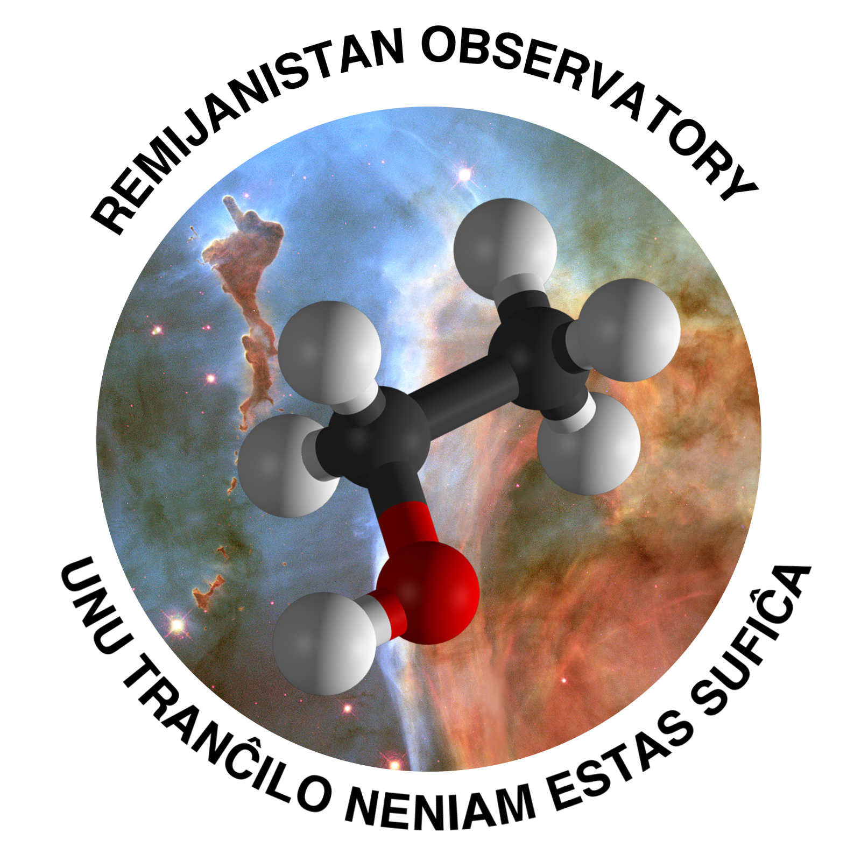
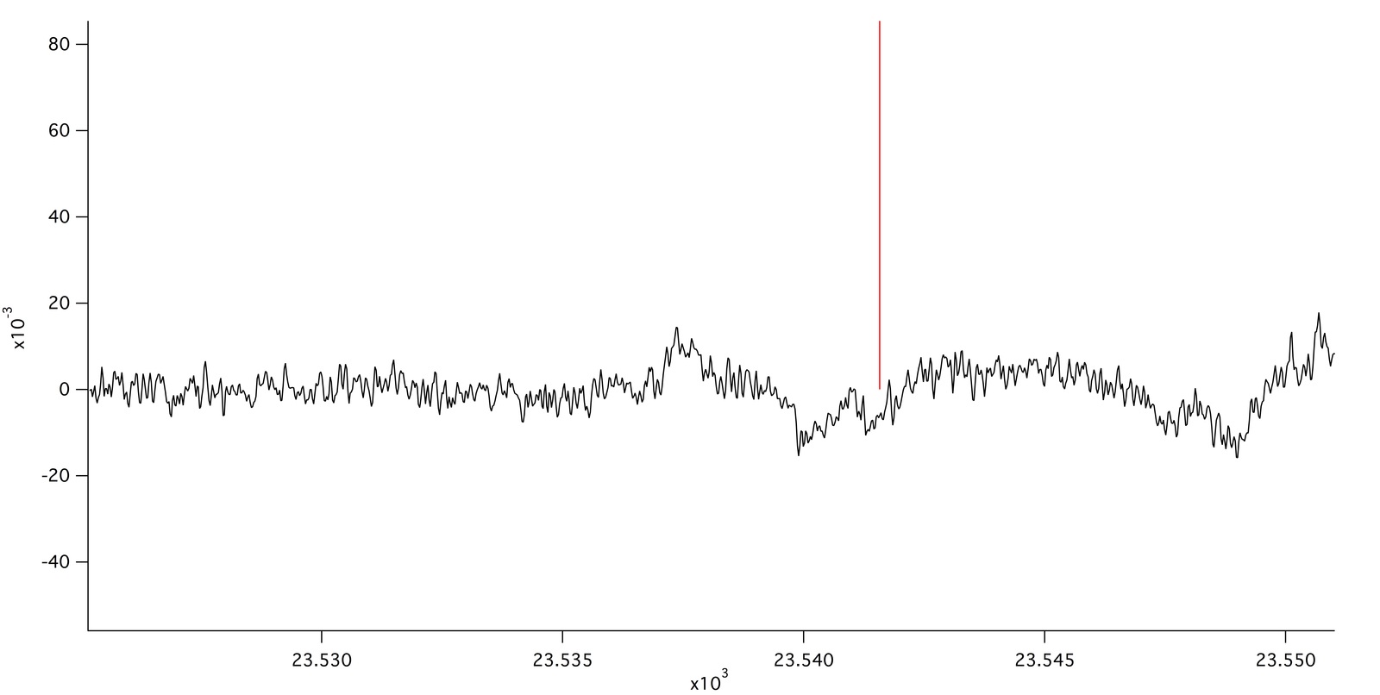
Questions, comments?
HONO 1(0,1) – 0(0,0) detection?

